Slide 1
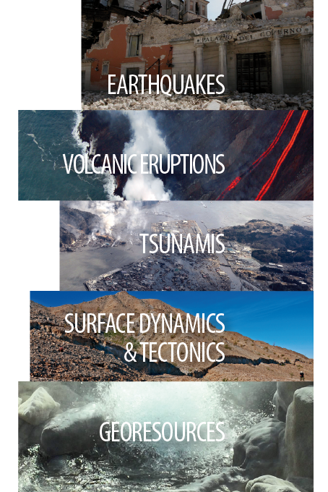
EPOS
European Plate Observing System
Matt Harrison
British Geological Survey
And the EPOS Community
OGC/Bsi Geotechnical Standardisation Workshop
Paris, 22nd January 2019

Slide 2
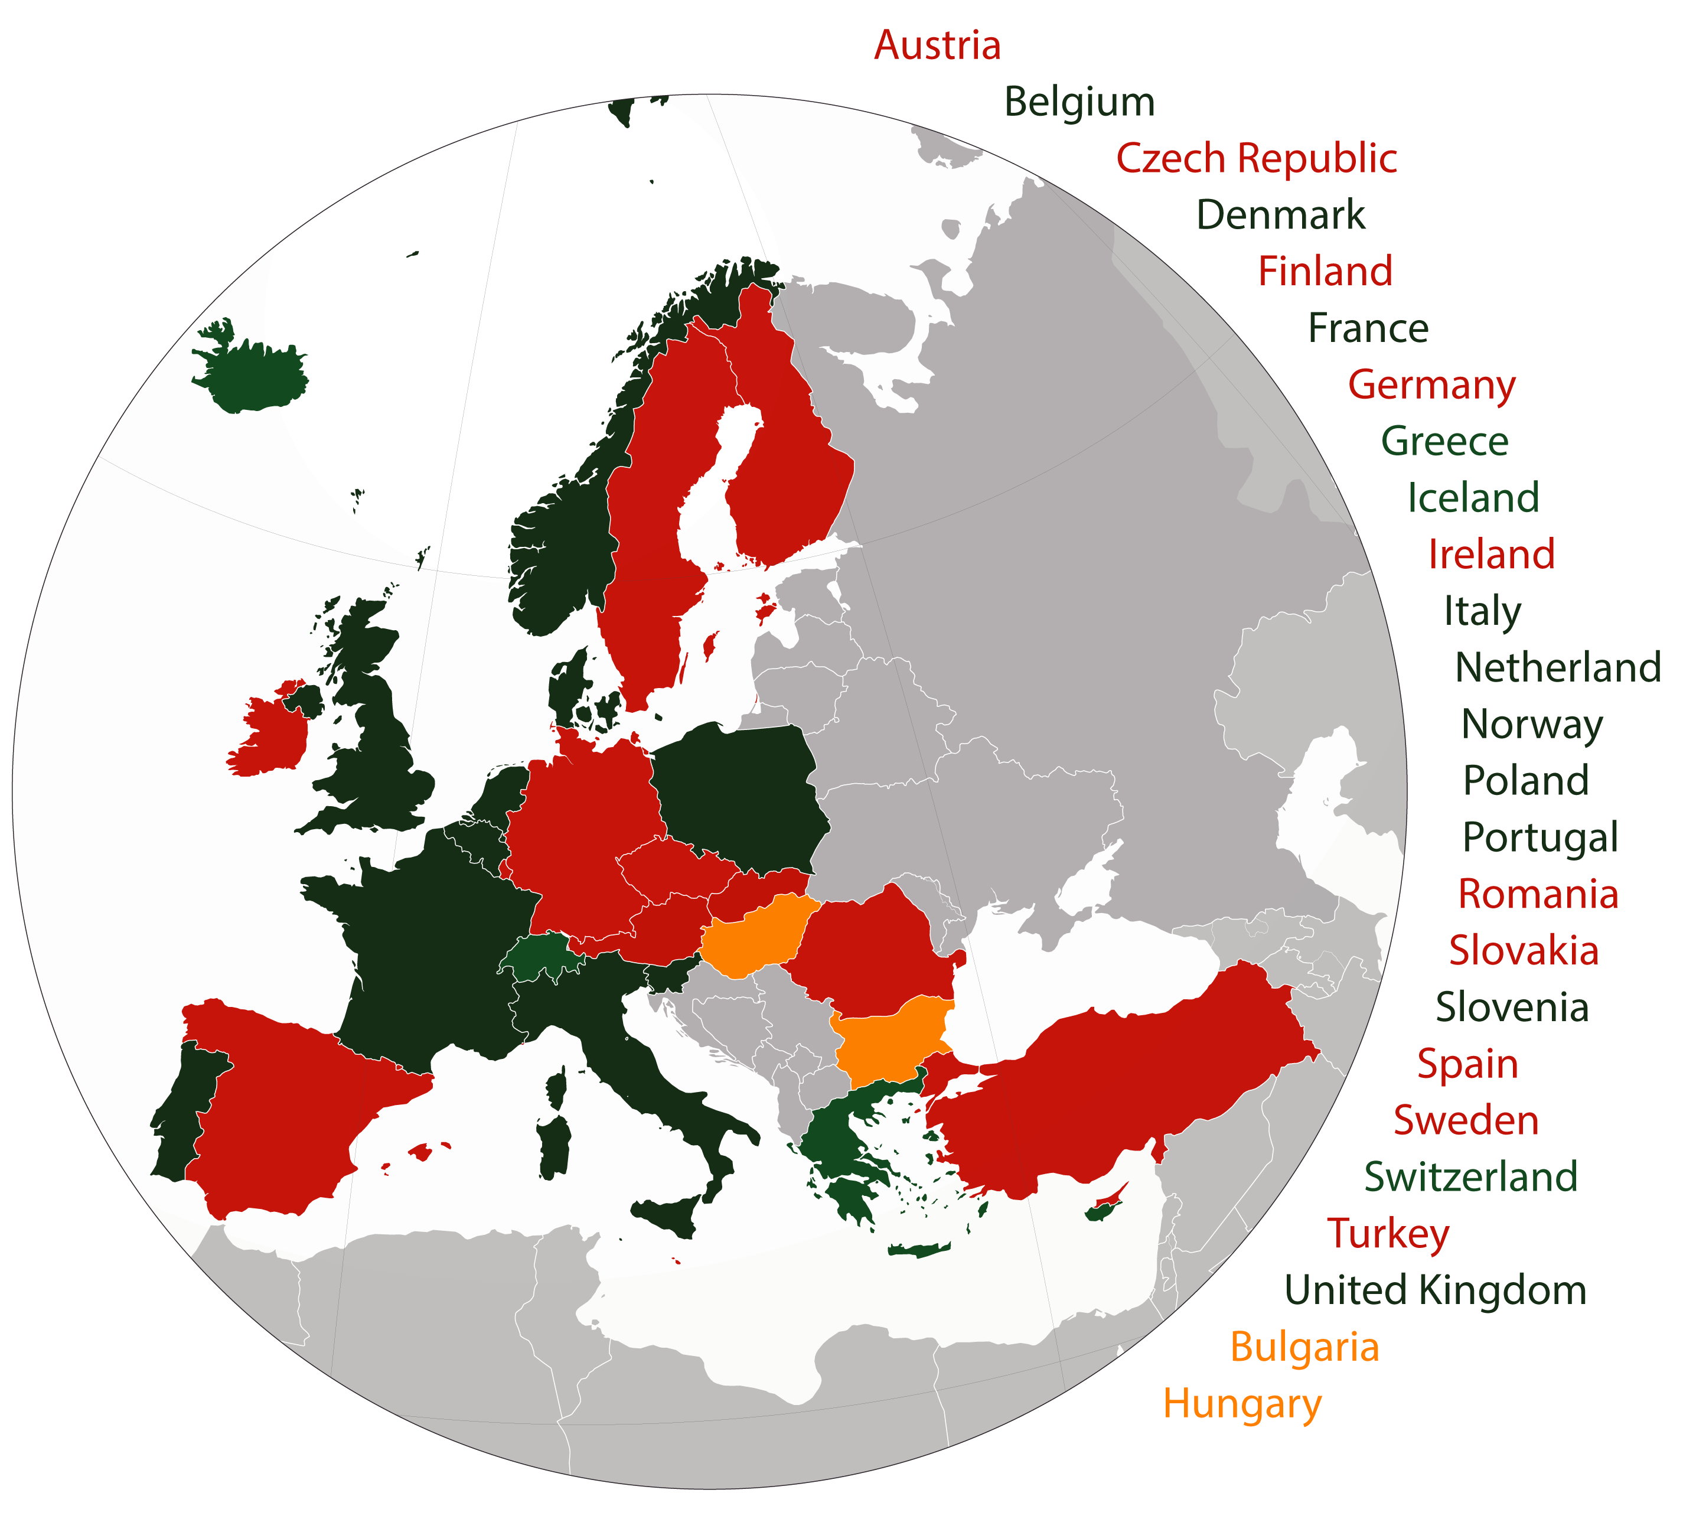
On October the 30th the European Commission granted the legal status of European Research Infrastructure Consortium to EPOS

Slide 3
30 October 2018: EPOS ERIC Granted by EC
Conception
NERIES
EC projects
EXPLORIS
Preparatory
Design
Plan
Implementation
Implement
A key result achieved through a construction process lasted 10 years
2002 2007-2008
2010 2014
2015 2019

Slide 4
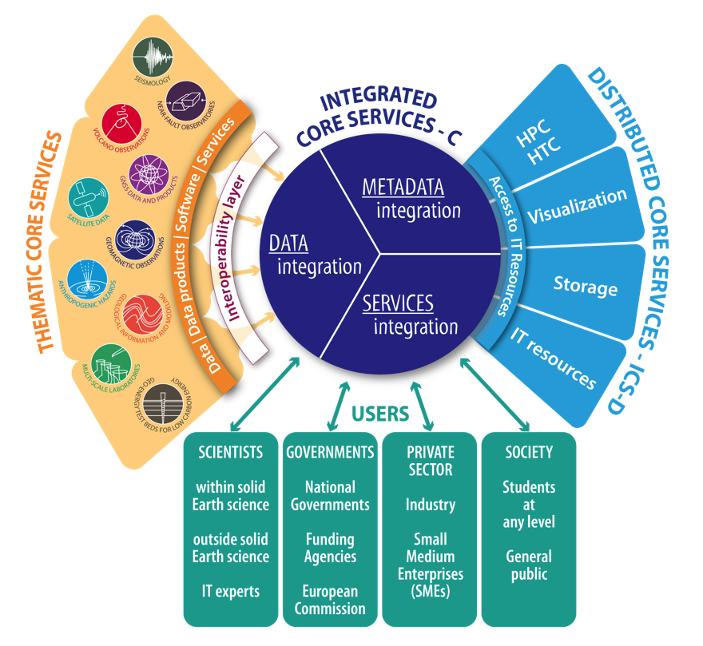
Technical implementation
ICS-C development: interoperability demonstrator, user management
TCS development:
Data, Metadata, products, services implementation
ICS-D design:
e-infrastructure providers, procurements
NRIs
National RIs &
International organizations
Communication: moving toward a user-driven engagement

Slide 5
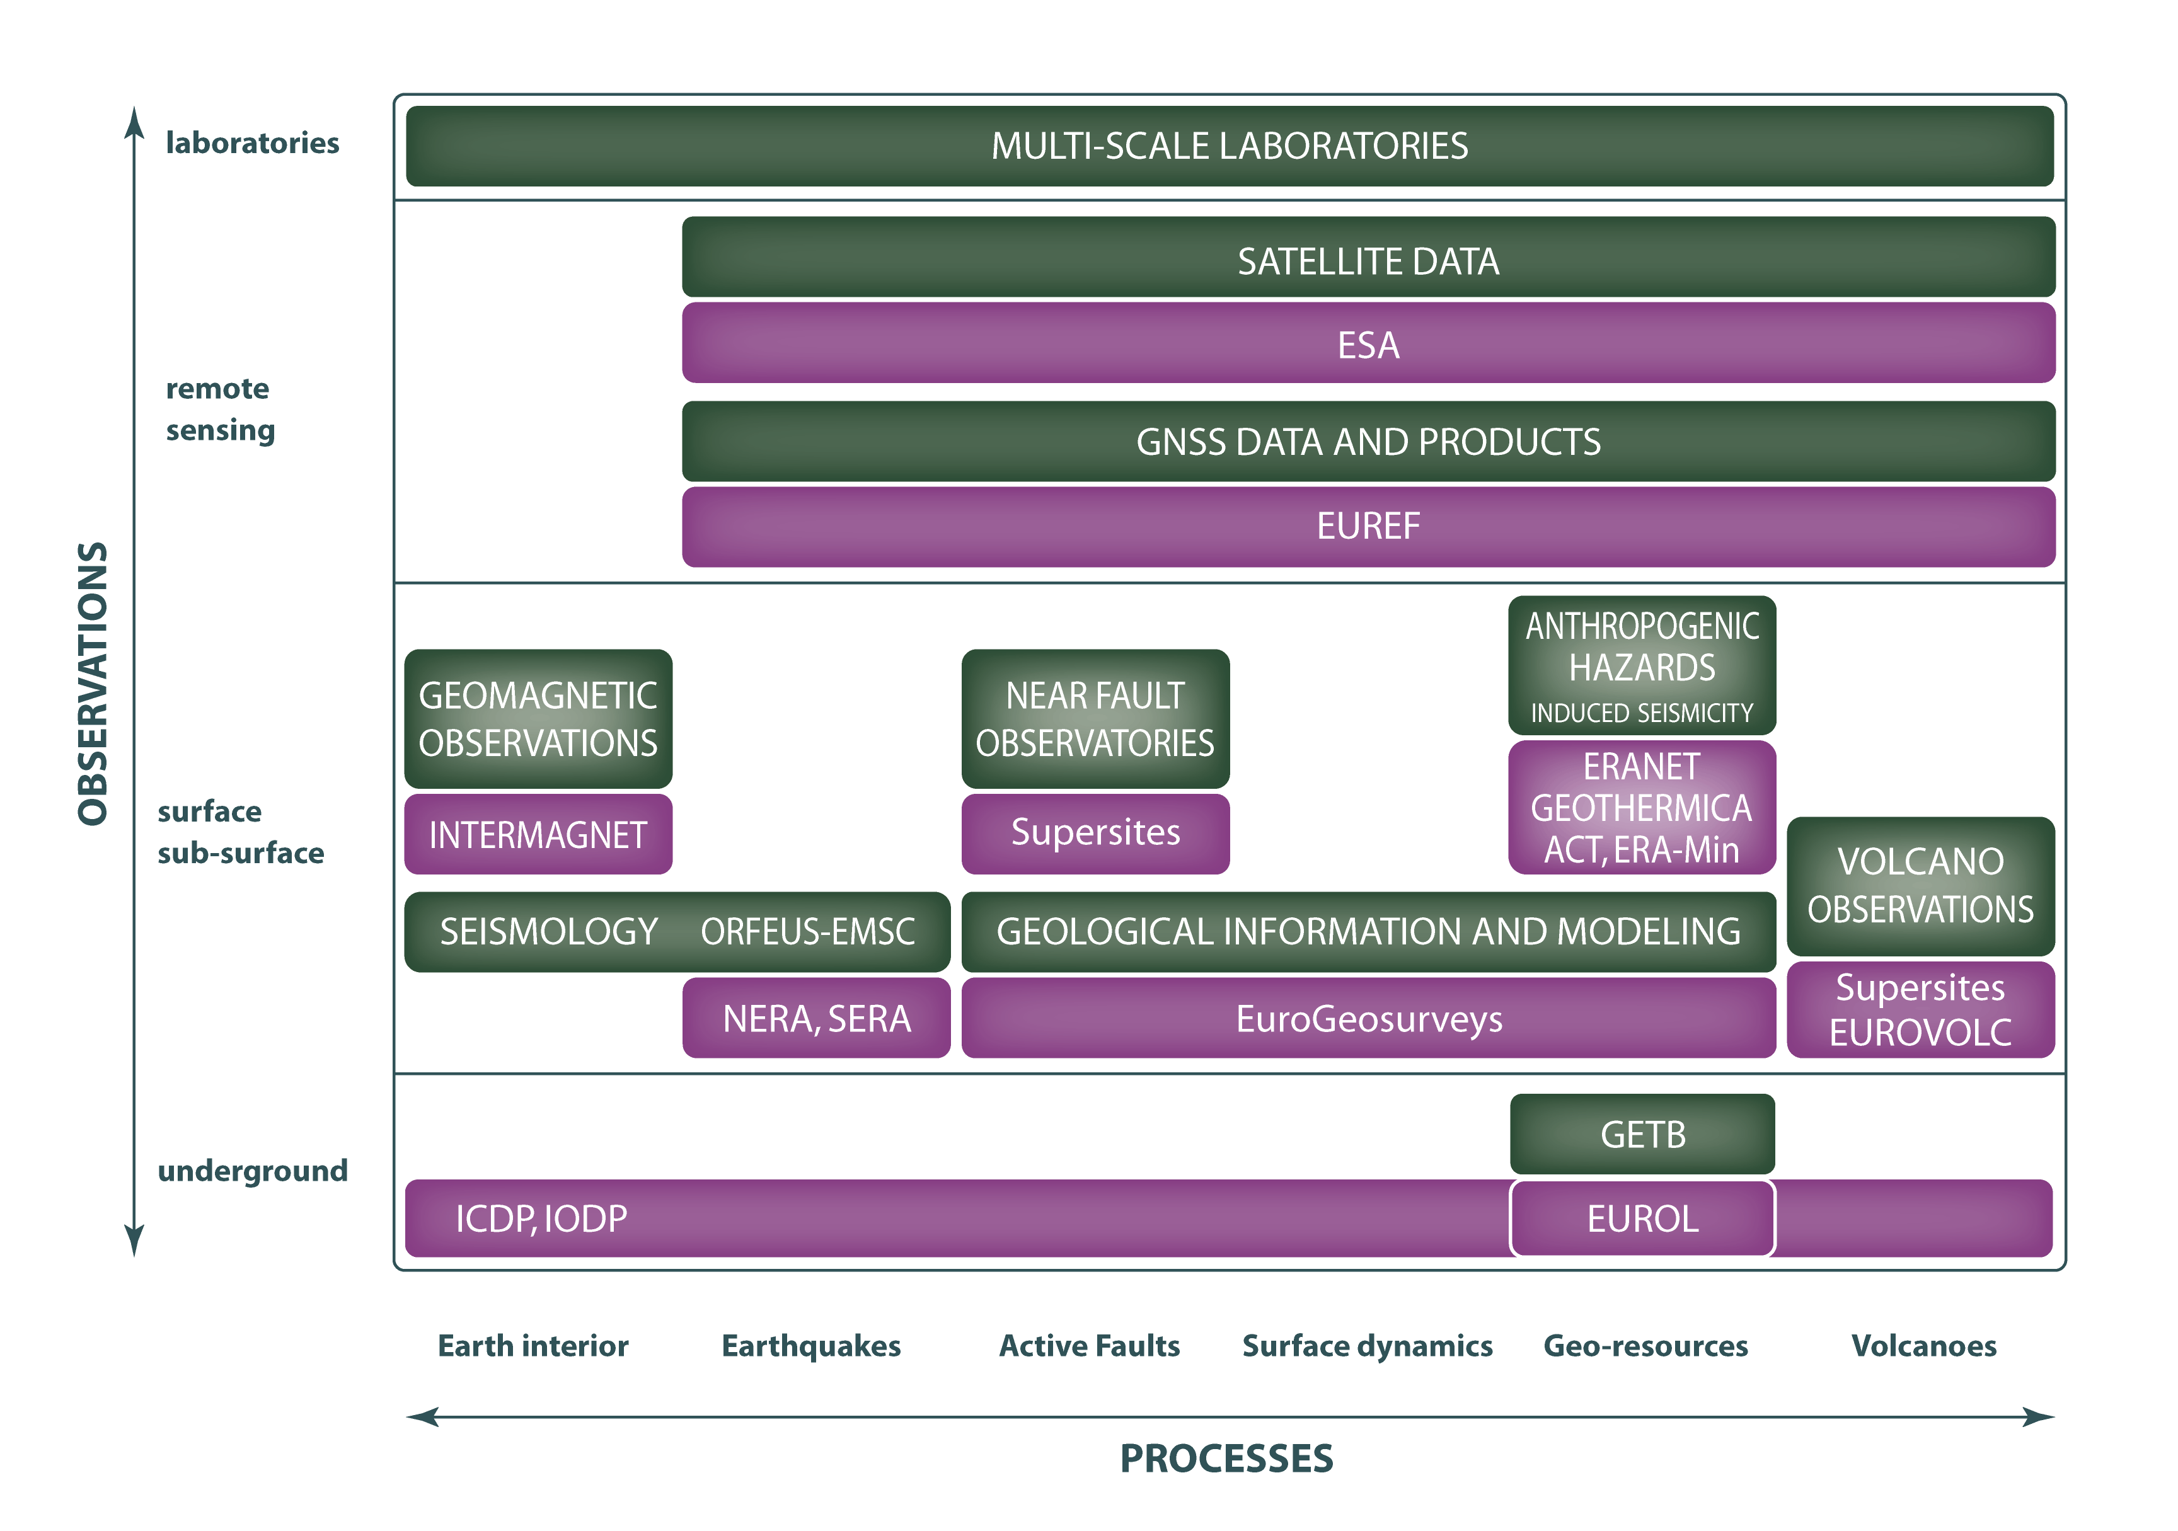
EPOS Scientific Framework

Slide 7
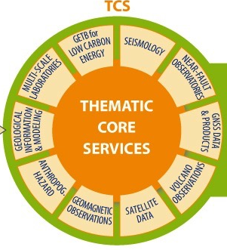
Borehole in EPOS
Core notion for Thematic Core Service ‘Geological information and modelling’
But also of interest for other TCSs
Near fault observatories,
Volcano observation,
Anthropogenic Hazards,
Multiscale Laboratories,
Geo-Energy,
…

Slide 8

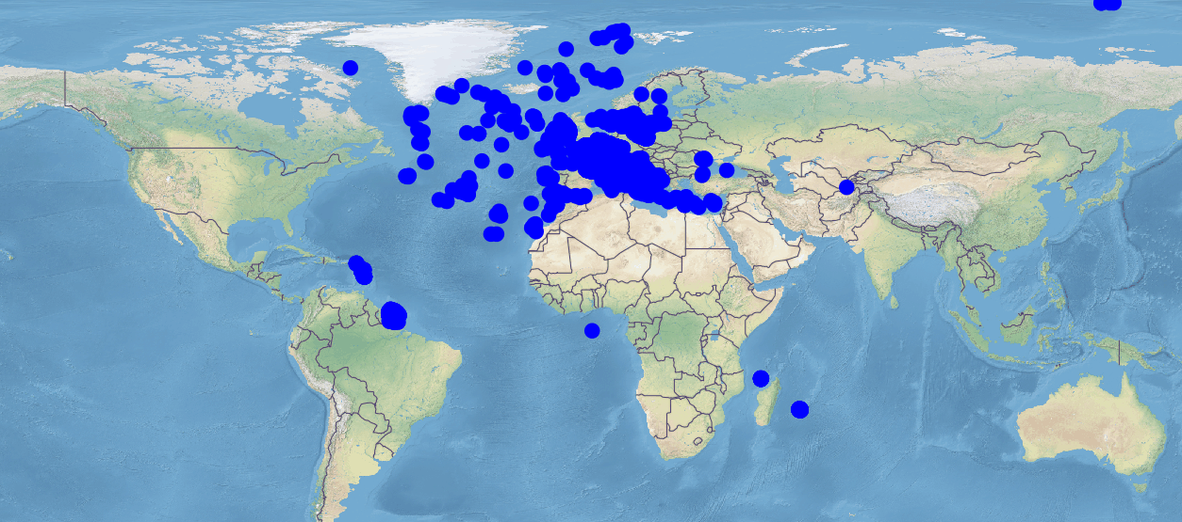
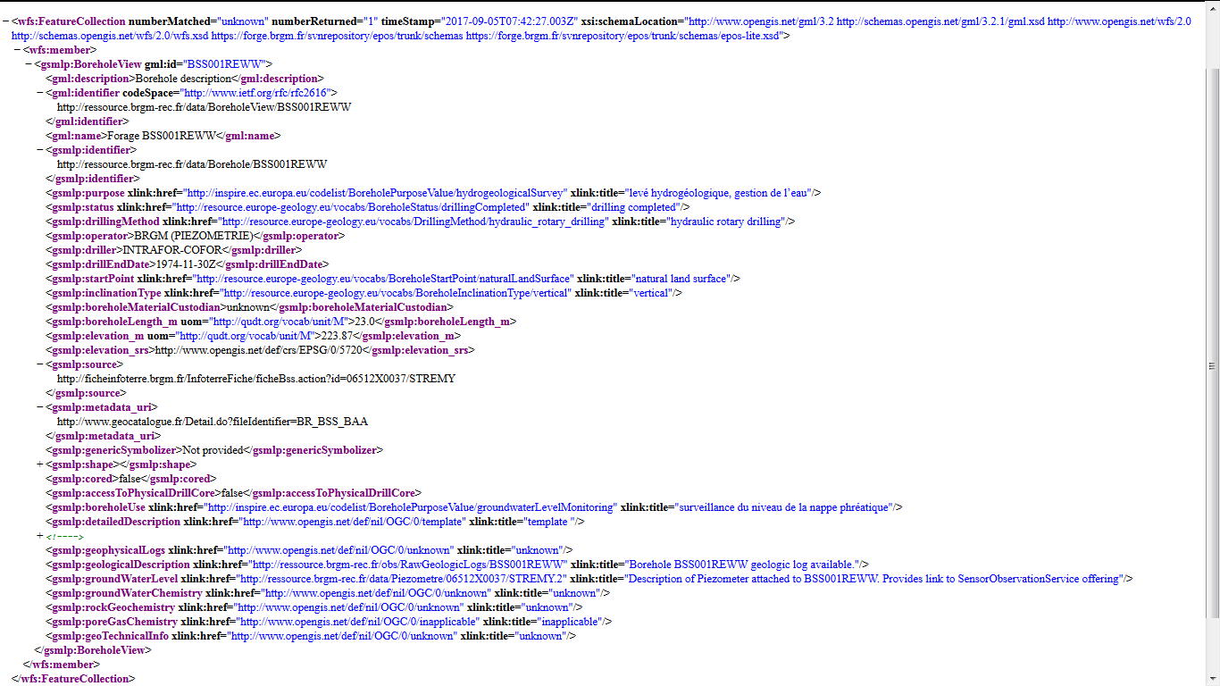
Focus on : BoreholeIndex example
WMS
URI to each BoreholeIndex entry
WFS
URI to codeList entries (INSPIRE, WP15)
URI to richer information resource (see next slide)

Slide 9



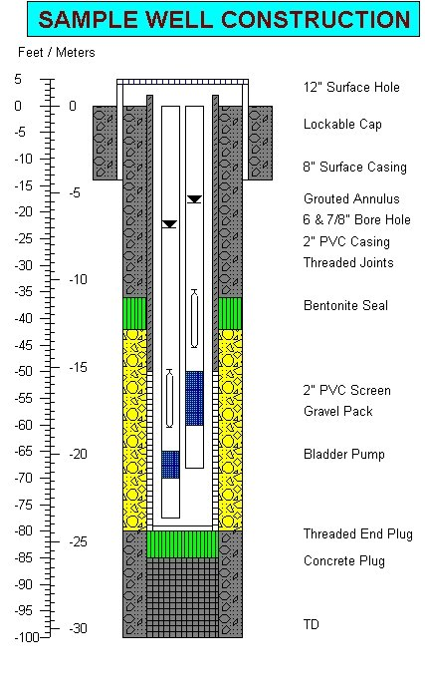
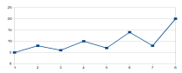
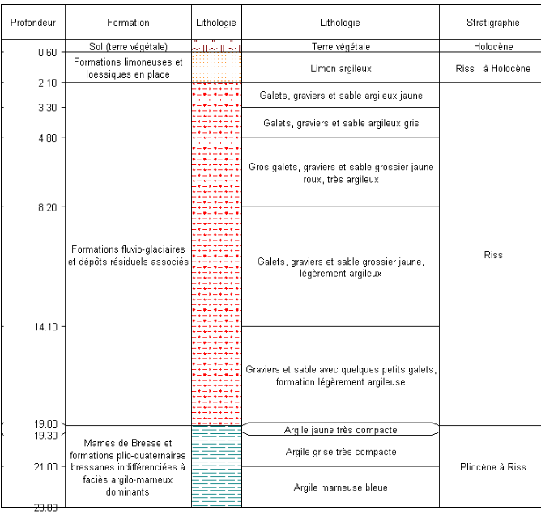
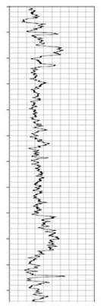
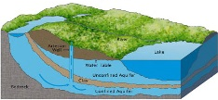
Focus : accessing richer Borehole flows
detailedDescription -> (URI)
Borehole Index
groundWaterLevel, groundWaterChemistry, … -> (URI)
gsmlp:identifier-> (URI)
Env. Monitoring Facility
URI
URI
Construction
details
Observations
URI
Borehole
URI
URI
URI
gsmlp:geophysicalLogs
gsmlp:geologicalDescription -> (URI)
URI
URI
Observations / logs
Geology / HydroGeology
URI

Slide 10
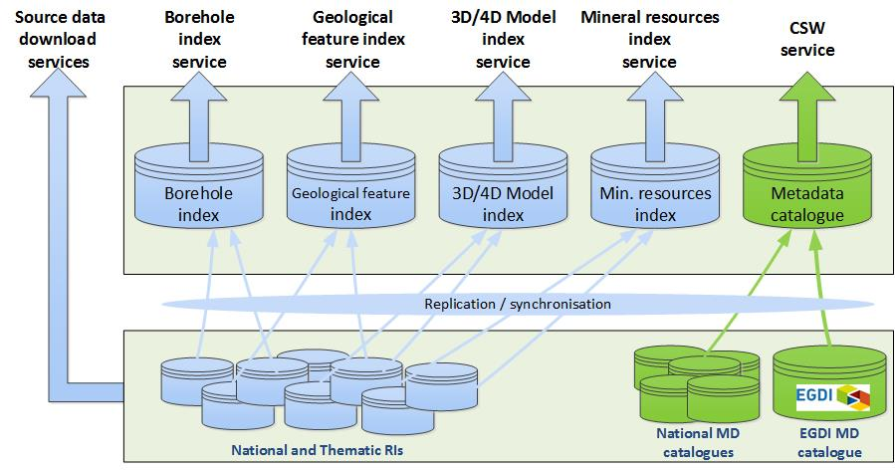



Data sources

Slide 11

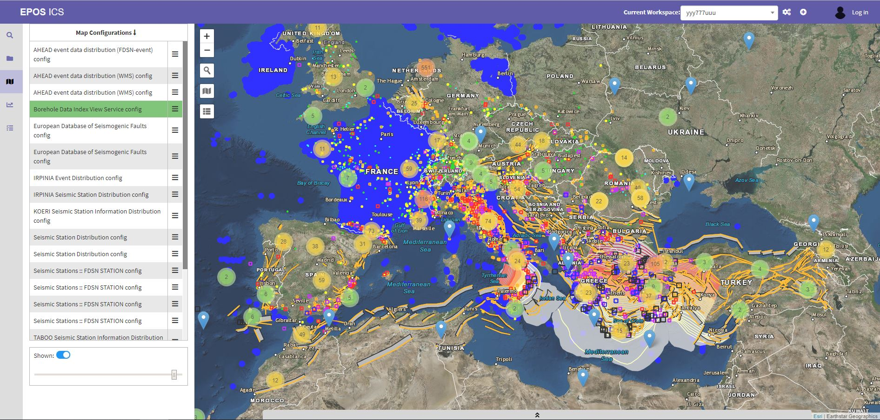
ICS-C Prototype at M36
ICS Data Access Page

Slide 12
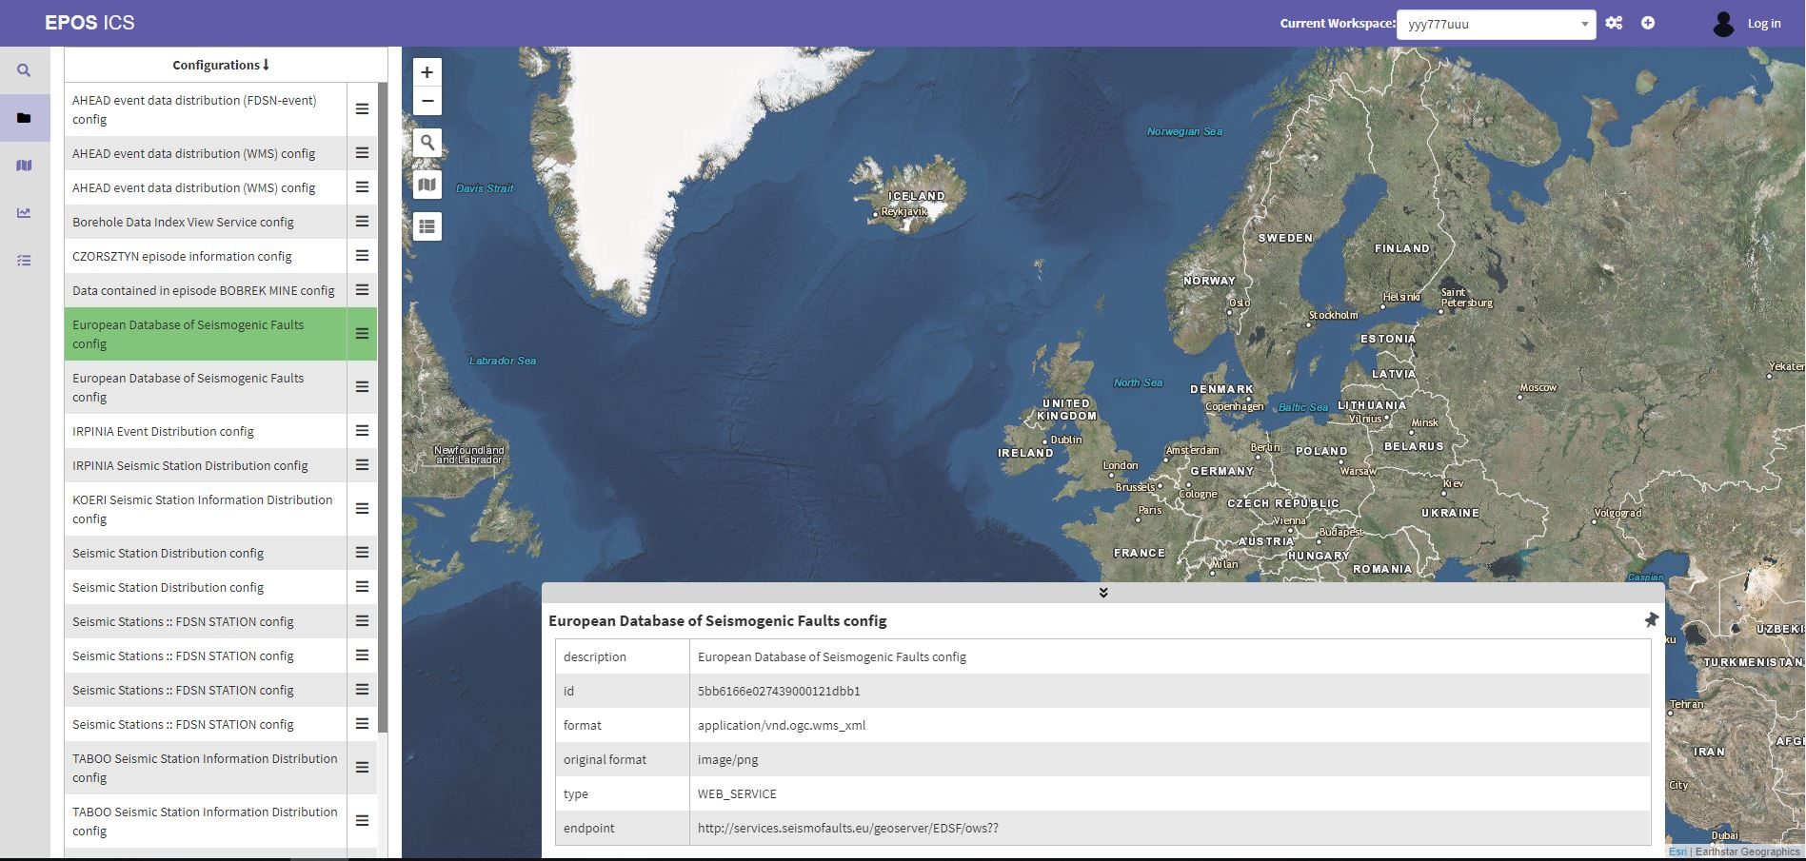
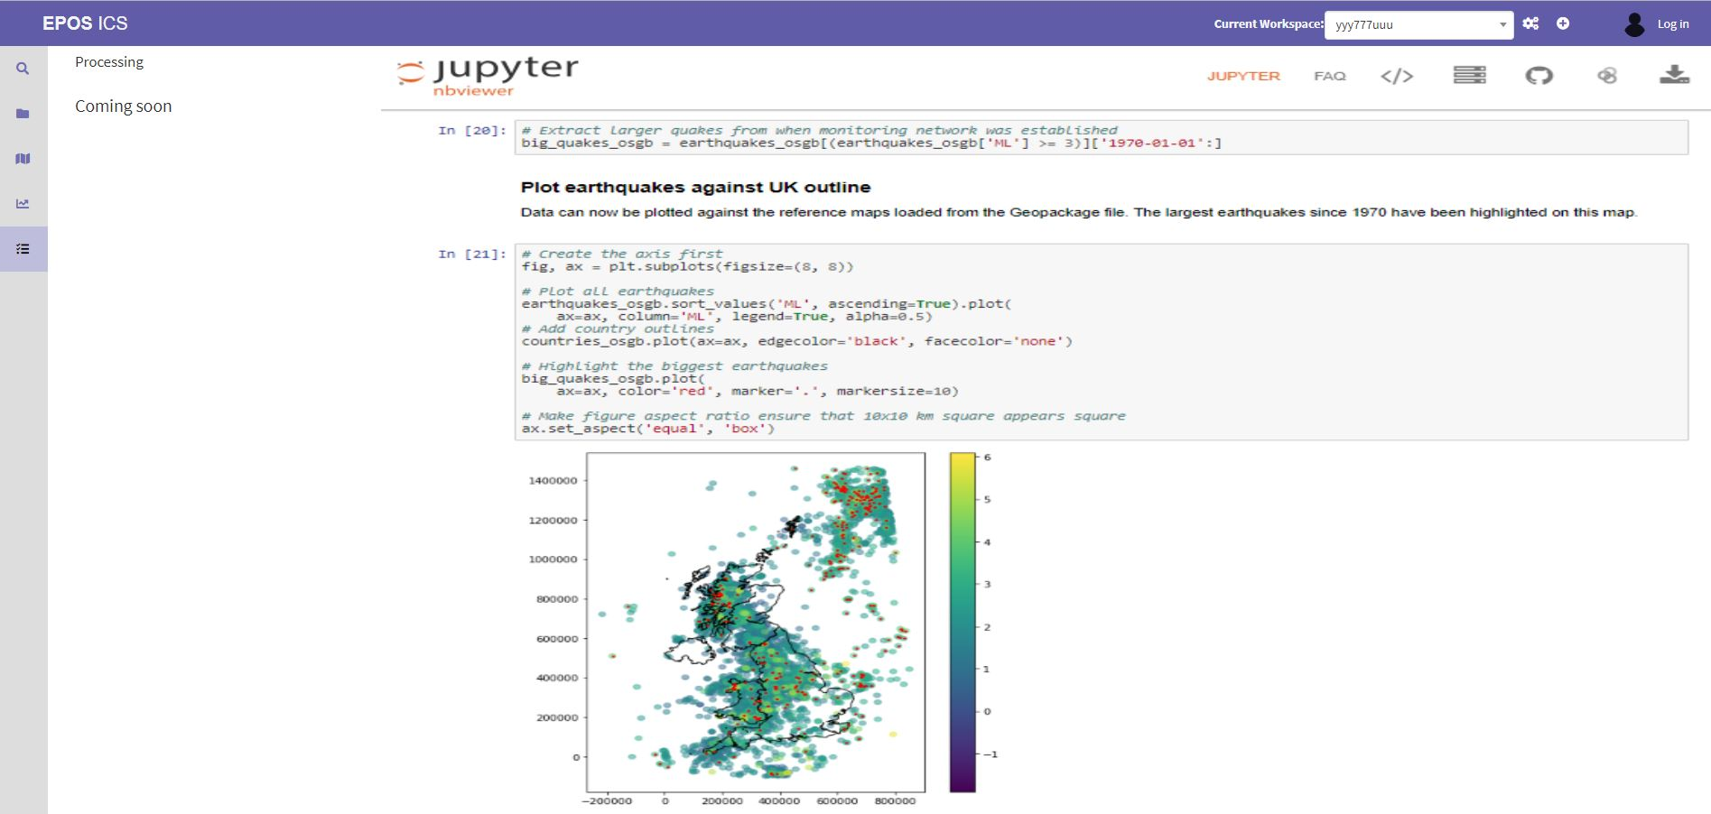
ICS-C Prototype at M36
ICS Workspace
ICS Virtual Research Environment

Slide 13
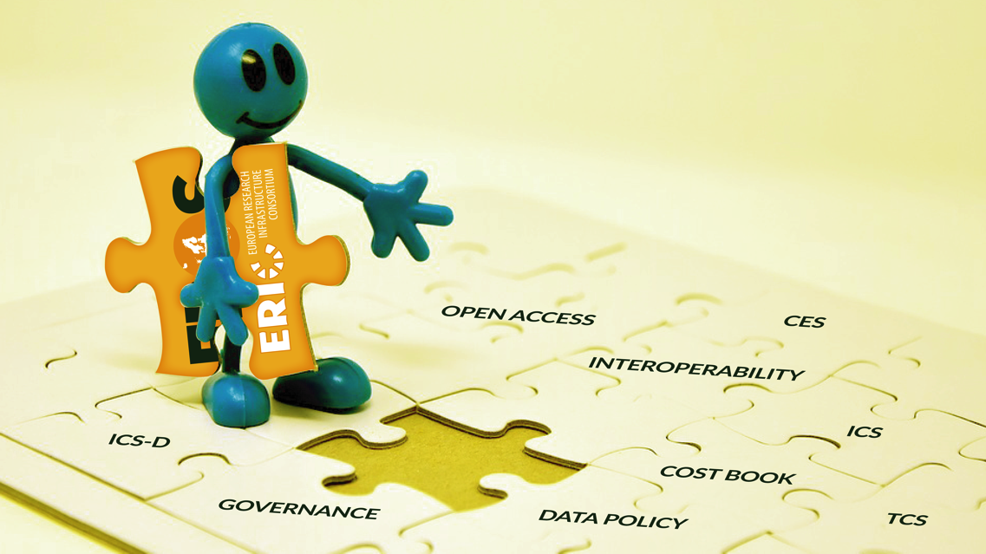
EPOS ERIC starts its operational phase
The establishment of EPOS ERIC is a cornerstone and it is now changing the framework and the perspective
The new framework relies on
Operational performances of the EPOS Delivery Framework (TCS & ICS)
Financial viability and long-term sustainability
EPOS ERIC governance shared with TCS & ICS communities
EPOS ERIC challenge is now to ensure long-term sustainability
to the initiative

Slide 14
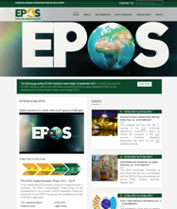
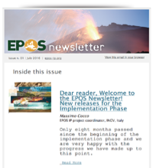


Thank You
WebSite
Newsletter
Social Media
www.epos-ip.org
www.epos-ip.org/news-press/
epos-ip-newsletter

